Slide 1
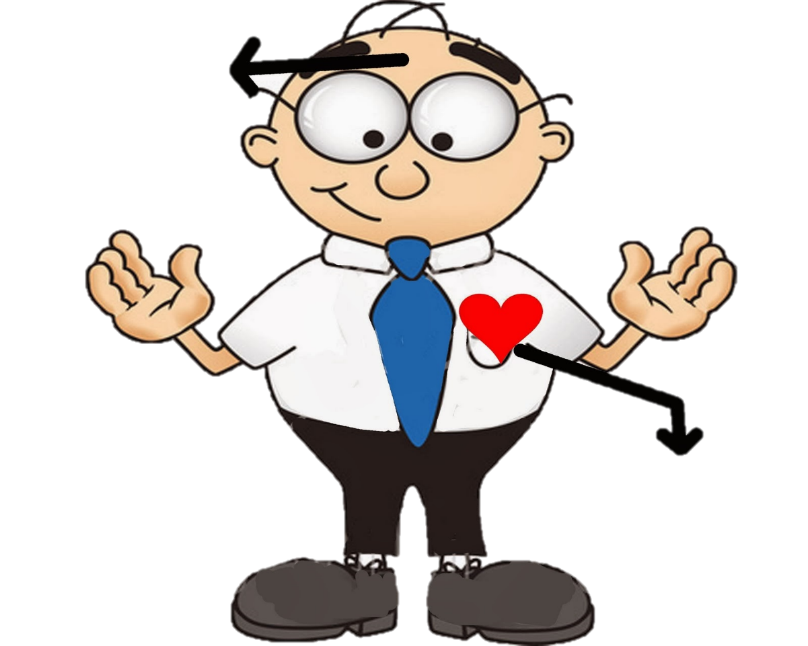
Tone and Mood
Tone
Mood

Slide 2
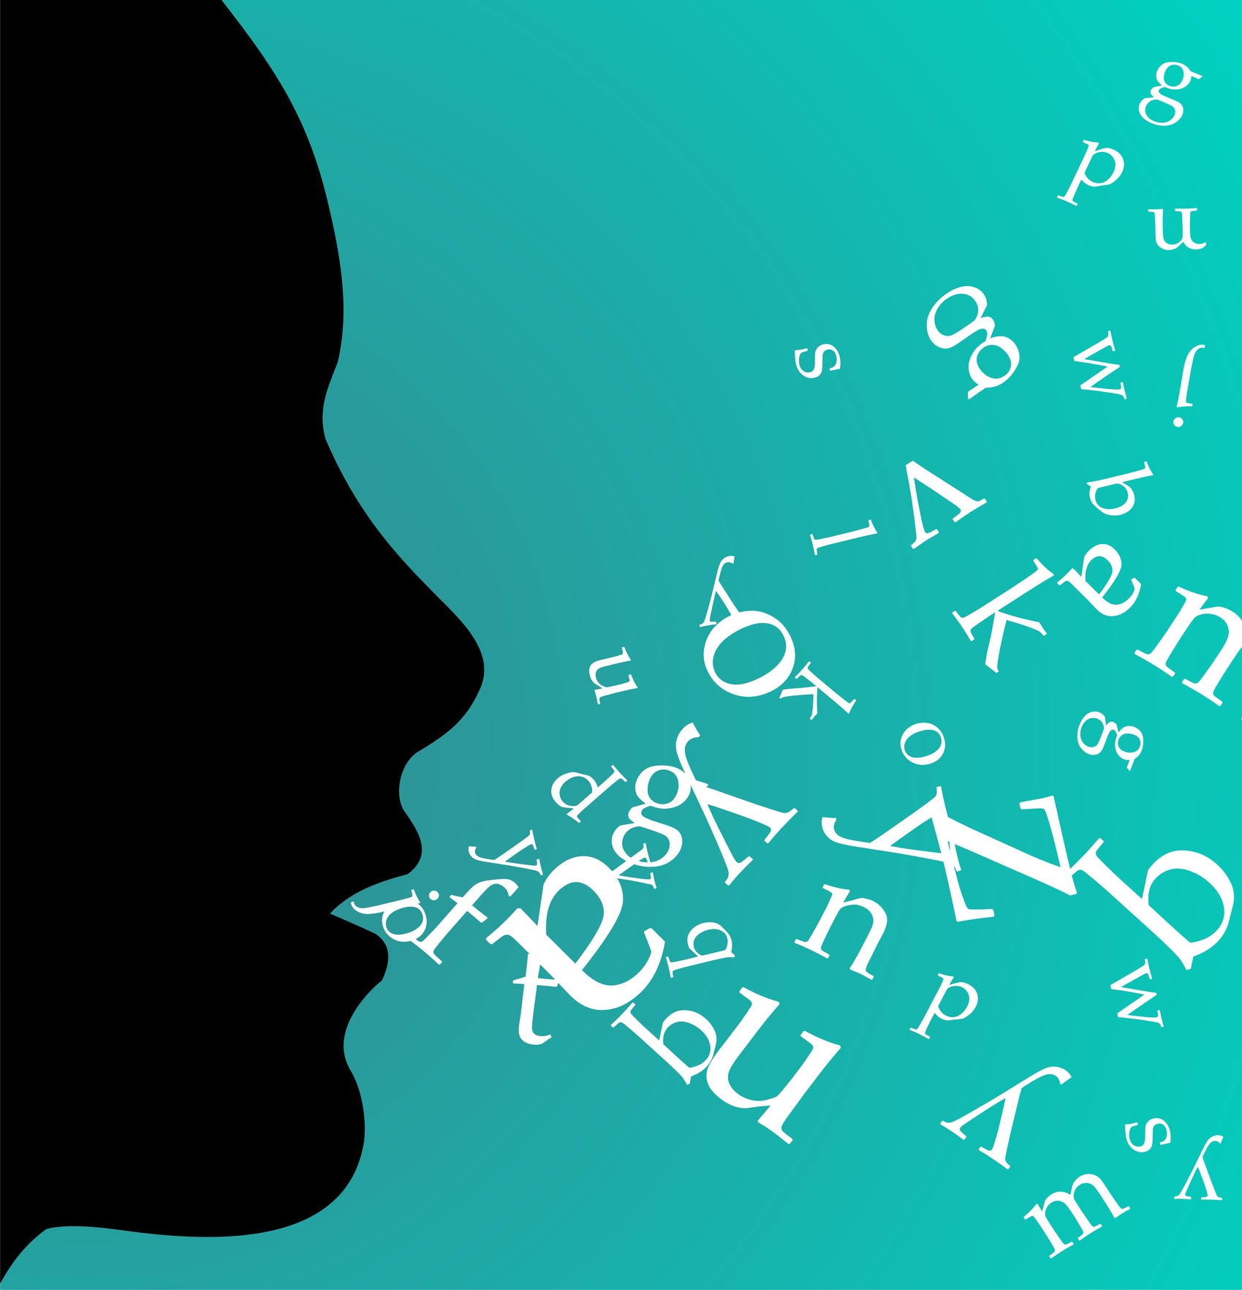
Bell Ringer:
When you think of the word home what images come to mind? What other words come to mind?
Day 1
Today’s Agenda
Materials:
- Pencil / Computer
- Digital and/or Printed Notes Document
Connotation & Denotation
Define
Connotation/Denotation of Animals
Connotation/Denotation of Sports Teams.
Notes and Activity
The power of synonyms
Paragraph Writing
Homework: Finish your “gross” paragraph!

Slide 3
Discussing the Bell Ringer:
HOME
What images come to mind when you read/hear the word “home”?
What other words come to mind?

Slide 4
Discussing the Bell Ringer:
HOME
What other words come to mind?
family
comfort
security
safety
love
These words show the emotion you feel when you hear the word home!

Slide 5
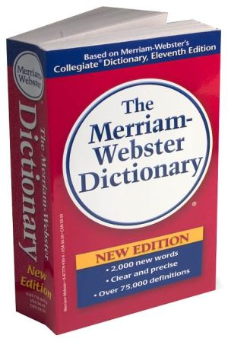
Define (in your notes)
1. Denotation = Dictionary Definition
2. Connotation = emotion or human reaction to a word.
(How we feel when we read the word.)

Slide 6
Consider the word RED:
Denotation:
“Of a color at the end of the spectrum next to orange and opposite violet”
Connotation:
?
What do we usually associate with the color red? How does this word make people feel?

Slide 7
Consider the word RED:
Denotation:
“Of a color at the end of the spectrum next to orange and opposite violet”
Connotation:
Love
Passion

Slide 8
Connotation with Animals: The Weasel
Denotation:
A Weasel is a small carnivorous mammal with short legs and elongated body and neck.
Connotation:
?
When you call a person a weasel- what does this mean?

Slide 9
Connotation with Animals: The Weasel
Denotation:
A Weasel is a small carnivorous mammal with short legs and elongated body and neck.
Connotation:
A person that is sneaky and cannot be trusted.
Create your Own:
Create a sentence using the word weasel. Share with your neighbor.

Slide 10
Connotation with Animals: The Activity
Directions:
With a partner, use the
Connotative Animals Worksheet
To determine the denotation and connotation of several common animals.

Slide 11
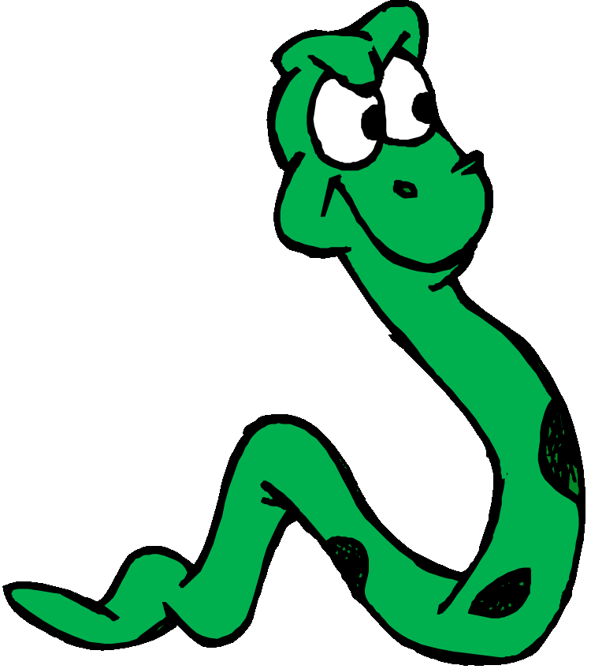
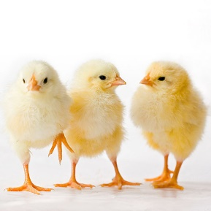
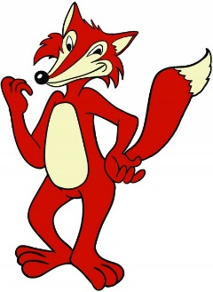
Connotations of Animals
Snake:
Feared for its deception
Fox:
Sneaky or Sly.
Shark:
Ruthless
Dove:
Gentle
Chicks:
A female of desire
Owl:
Wise

Slide 12
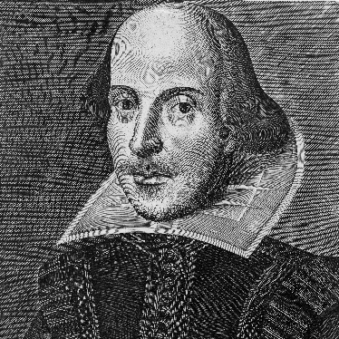
What’s in a name?
“What’s in a name? That which we call a rose by any other name would smell as sweet”
-William Shakespeare

Slide 13
What’s in a name?
Consider the following sports teams:
Discuss the following questions with a neighbor:
Why were these team names chosen?
Why is it important to have a team name that inspires an emotional response in people?

Slide 14
Positive VS Negative Connotations
Words can have a positive, neutral, or negative connotation.
Place the following words in the Positive or Negative Connotation Column in your notes:
ambitious vs greedy
manufactured home vs trailer
eccentric vs weirdo
thrifty vs. tightwad
inexpensive vs cheap
chef vs. cook

Slide 15
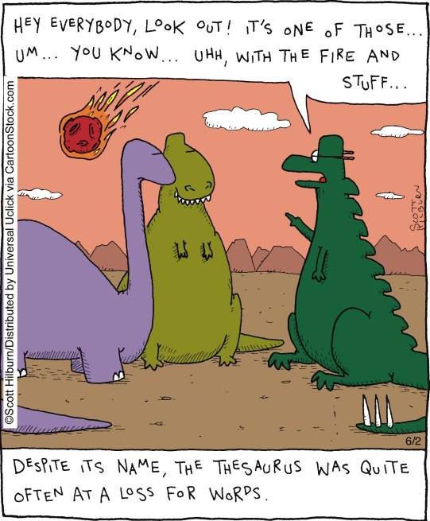
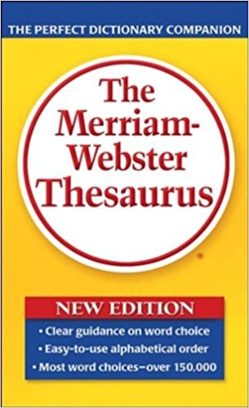
As an author, how can we choose strong connotative words?
SYNONYMS!

Slide 16
Laugh:
Strong VS Weak Connotations
Your goal is to express the most hilarious situation. What are the strongest words to do this? What are the weakest words? WHY?
Synonyms:
Giggle
Chuckle
Cackle
Chortle
Hoot
Howl
Strong | Neutral | Weak
Roar
Guffaw
Snicker
Burst out laughing
Rolling on the floor
Split one’s sides

Slide 17
gross:
Strong VS Weak Connotations
Now you try! Find synonyms for the word gross, then place these on the chart in your notes!
Strong | Neutral | Weak
Synonyms:
?

Slide 18
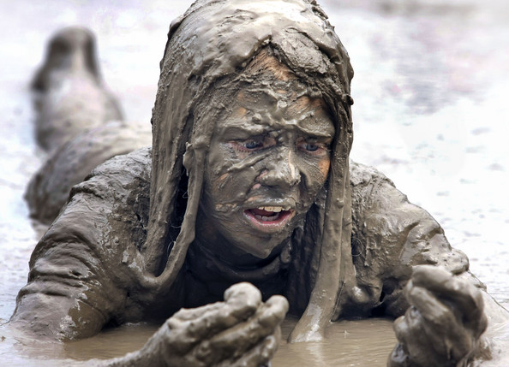
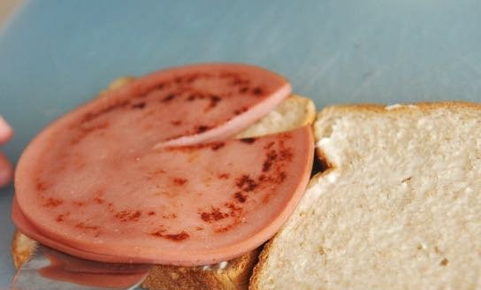
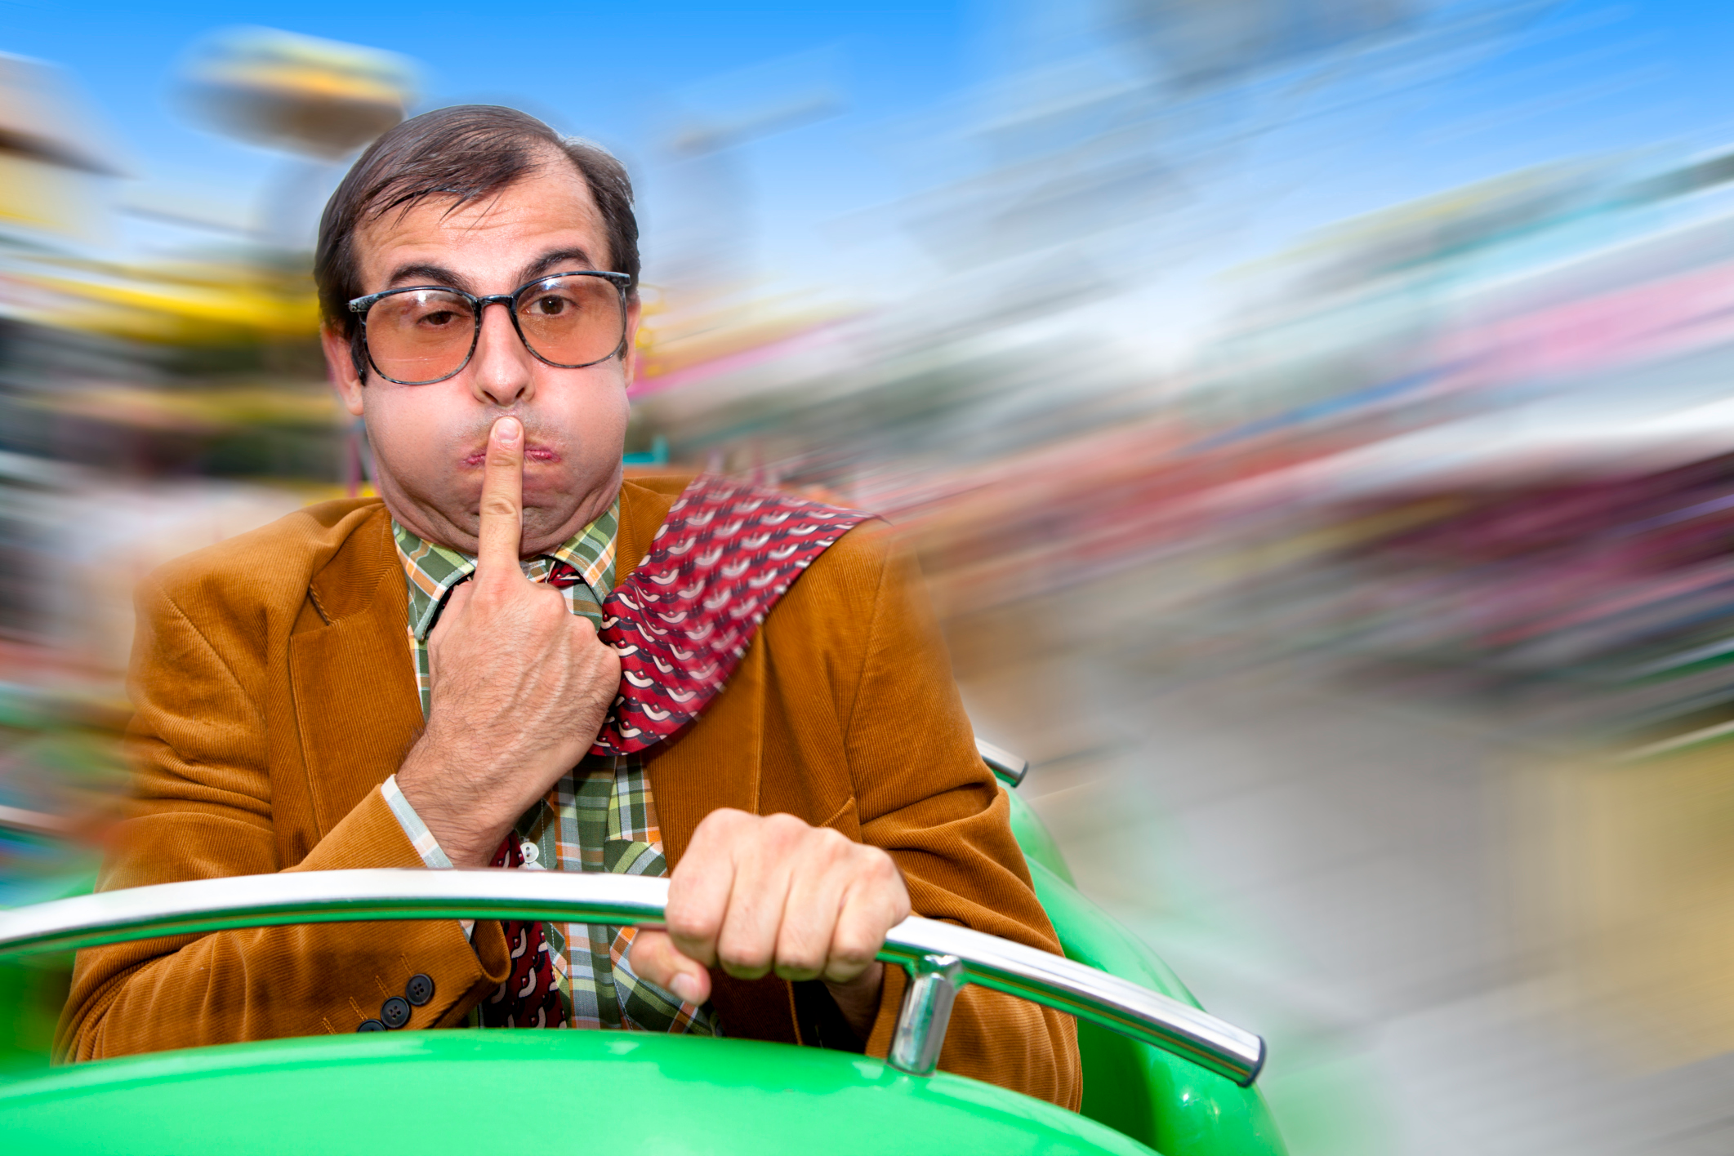
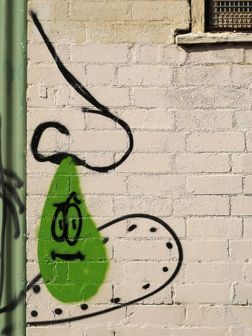
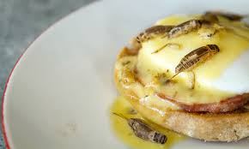
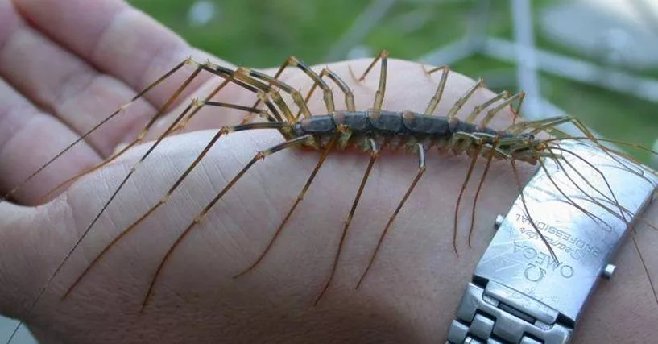
gross!
Strong VS Weak Connotations
Use the strongest connotation words to describe (in a paragraph) a gross situation/moment/thing/event that you have experienced.

Slide 19
Exit Ticket
Read the following passages and choose the appropriate word based on the connotation of that word:
1. “Here is a scholarship that you might qualify for,” said David’s advisor. “It’s for people who are ___________.
A. underprivileged B. poor C. poverty-stricken
2. We are extremely worried about Suzie’s health; she has lost so much weight that she looks ___________.
A. trim B. boney c. slender
3. Put the following words into the chart below based on their connotative meaning.
Corpulent, Plump, Obese, Heavyset, Fleshy, Fat, Paunchy, Burly, Overweight, Roly-poly, Bulky, Portly, Weighty, Pudgy
Strong | Weak

Slide 20
Bell Ringer:
On the next slide!
Day 2 & 3
Today’s Agenda
Materials:
- Pencil / Computer
- Digital and/or Printed Notes Document
Tone & Mood
Define
Let’s talk feelings
Tone and Mood in FILM
Tone and Mood in ART
Tone and Mood in LITERATURE
Tone and Mood GAME!
Homework:

Slide 21
Bell Ringer:
Directions:
Read through the passage below. How does the author feel about his day? How do you know? What words help you to understand how the author feels?
Why do these things always happen to me? Brad wondered. First, I forget an important meeting, and nobody reminds me until it’s over. Then, my boss dumps a big project on my desk and wants it done by yesterday. And to top everything off, I leave my wallet on the bus.

Slide 22
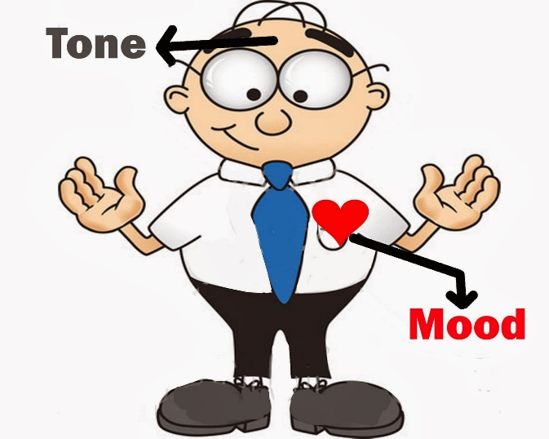
Definition Fun – Tone & Mood
Tone is the author’s attitude or feeling about the subject that he/she writes about.
Tone:
Mood is how you, the audience, feels when reading or viewing the author’s work.
Mood:

Slide 23
Consider the Following Statement:
“If I could give you one thing in life I would give you the ability to see yourself through my eyes, only then would you realize how special you are to me.” -Anonymous
Turn, Talk, & Tell
What is the author writing about (the subject)?
What is the author’s attitude about the subject?
How do you feel when you read this sappy quote?

Slide 24
“If I could give you one thing in life I would give you the ability to see yourself through my eyes, only then would you realize how special you are to me.” -Anonymous
What is the author writing about (the subject)?
His/her LOVE interest!
What is the author’s attitude about the subject?
He/She loves that person so very dearly!
How do you feel when you read this sappy quote?
Inspired? Moved? Happy? -- Disgusted? Creeped-out?
Heebie-Jeebies anyone?

Slide 25
The Take-Away:
What is the author’s attitude about the subject?
He/She loves that person so very dearly!
How do you feel when you read this sappy quote?
Inspired? Moved? Happy? -- Disgusted? Creeped-out?
Heebie-Jeebies anyone?
The author’s tone and your mood DO NOT have to match!

Slide 26
How does the author show you his/her tone?
-“Character Dialogue”
-Internal Monologue
-Diction (word choice—CONNOTATION!)
He said,
She said!
I think…
Positive, Neutral, Negative, oh my!
Strong Words
Weak Words

Slide 27
As you are watching consider both TONE AND MOOD.
How does the creator of this video feel about US Soldiers?
How do you feel about US Soldiers after watching this video?

Slide 28
Discussing Tone and Mood
How does the creator of this video feel about US Soldiers?
How do you feel about US Soldiers after watching this video?
Mood:
How do you feel about soldiers after watching this video?
Tone:
How does the author feel about soldiers?
Consider:
Why was this video created and shared with the world?
What does the author want to express about soldiers?
What does the author want to express about The United States?

Slide 29
As you are watching consider both TONE AND MOOD.
What is the TONE?
What is your Mood?
The Undeadening

Slide 30
Discussing Tone and Mood
How does the author feel? What is his/her attitude?
How do you feel? What is the atmosphere of the video?
Subject?
What is this really about?
Mood:
How do you feel after watching this video?
Tone:
What is the author’s attitude?
Consider:
Why was this video created and shared with the world?
What does the author want to express about CPR?

Slide 31
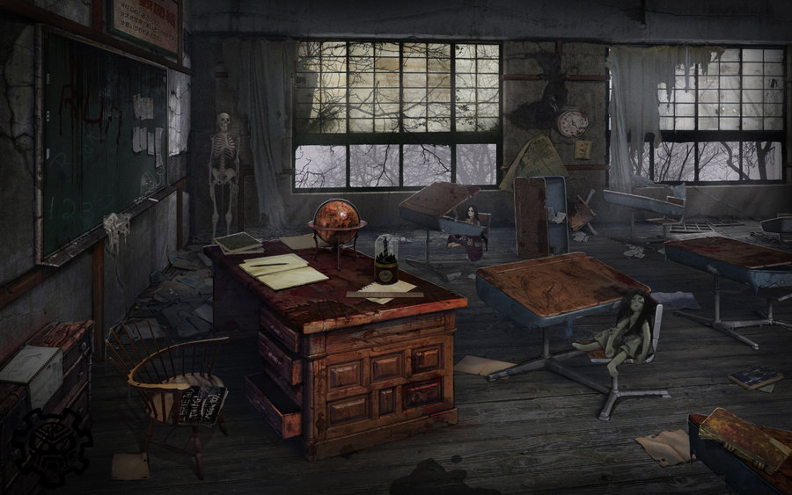
Discuss the Tone & Mood in These Pictures:
Subject= Classroom
Tone? Mood?

Slide 32
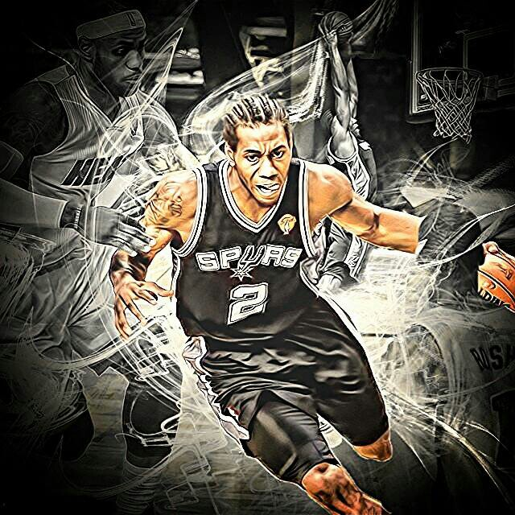
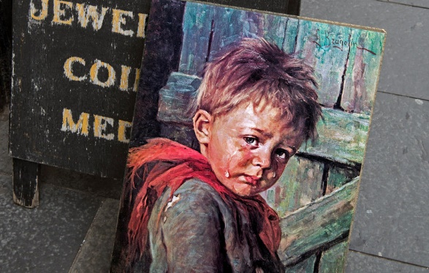
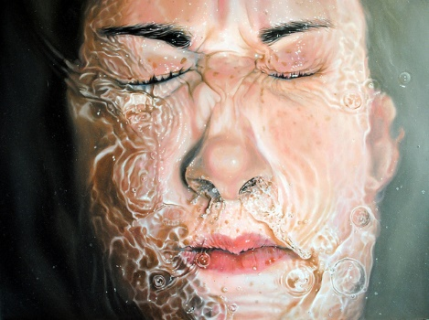
Discuss the Tone & Mood in These Pictures:
Subject? Tone? Mood?

Slide 33
What is the tone in the following passage?
The Things They Carried by Tim O’Brien.
“For the most part they carried themselves with poise, a kind of dignity. Now and then, however, there were times of panic, when they squealed or wanted to squeal but couldn’t, when they twitched and made moaning sounds and covered their heads and said Dear Jesus and flopped around to the earth and fired their weapons blindly and cringed and sobbed and begged for the noise to stop and went wild and made stupid promises to themselves and to God and to their mothers and fathers, hoping not to die” (O’Brien, 18).

Slide 34
What is the tone in the following passage?
The Things They Carried by Tim O’Brien.
What is the subject?
How does the author feel about that subject?
What words or phrases show you this tone?
“For the most part they carried themselves with poise, a kind of dignity. Now and then, however, there were times of panic, when they squealed or wanted to squeal but couldn’t, when they twitched and made moaning sounds and covered their heads and said Dear Jesus and flopped around to the earth and fired their weapons blindly and cringed and sobbed and begged for the noise to stop and went wild and made stupid promises to themselves and to God and to their mothers and fathers, hoping not to die” (O’Brien, 18).

Slide 35
What is the tone in the following passage?
The Things They Carried by Tim O’Brien.
What is the subject?
WAR
How does the author feel about that subject?
Realistic Terrified Fearful
What words or phrases show you this tone?
“For the most part they carried themselves with poise, a kind of dignity. Now and then, however, there were times of panic, when they squealed or wanted to squeal but couldn’t, when they twitched and made moaning sounds and covered their heads and said Dear Jesus and flopped around to the earth and fired their weapons blindly and cringed and sobbed and begged for the noise to stop and went wild and made stupid promises to themselves and to God and to their mothers and fathers, hoping not to die” (O’Brien, 18).

Slide 36
Tone and Mood Game:
You will work within groups of four. Within your small group split into teams of two. You will be competing against the other groups of four within the class.
Group 1:
Group 2: Repeat steps.
The group of four that guesses the MOST tone words in the time given wins! This group of four AMAZING TONE DETECTIVES will win a small prize!
Choose a TONE word from the deck.
Create a short skit to show this tone to the other team.
Do not use the tone word in your skit.
The other team attempts to guess the TONE word.

Slide 37
Bell Ringer:
Read the passage in your notes packet. Determine the tone of the poem, and highlight or circle the words that reflect this tone.
Day 4
Today’s Agenda
Materials:
- Pencil & Computer
Digital and/or Printed Notes Document
Prezi Notes Document
Tone & Mood
Tone and Mood Prezi of FUN!
Homework: Finish Prezi & Notes!
Notes:
Link to the prezi: http://prezi.com/rutfyydkimgn/?utm_campaign=share&utm_medium=copy&rc=ex0share

Slide 38
Bell Ringer:
Once upon a midnight dreary, while
I pondered, weak and weary,
Over many a quaint and curious
volume of forgotten lore,
While I nodded, nearly napping,
suddenly there came a tapping,
As of someone gently rapping,
rapping at my chamber door.
The Raven- Edgar Allen Poe
Directions:
Read through the passage. What is the tone of the poem? What words showcase this tone?

Slide 39
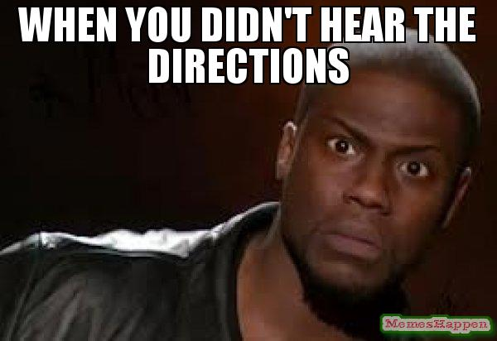
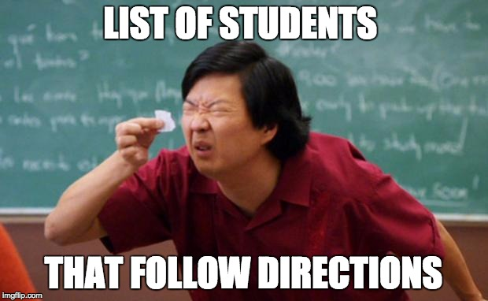
Prezi Directions
-Complete the Prezi with a partner.
-Use the notes document given to you in class to write down your responses!
-You will each complete your own notes document.
-Turn this in when complete.
-Read from your novel when finished.

Slide 40
Bell Ringer:
Read the passage in your notes packet. Determine the tone of the poem, and highlight or circle the words that reflect this tone.
Day 5
Today’s Agenda
Materials:
- Pencil & Computer
Digital and/or Printed Notes Document
Paint Sample
Tone & Mood
Tone and Mood Writing Activity
Short Story Swap
Homework: Finish Writing Activity
Notes:
Link to the prezi: http://prezi.com/rutfyydkimgn/?utm_campaign=share&utm_medium=copy&rc=ex0share

Slide 41
Bell Ringer:
I stand in the rain waiting for my bus
And in the bus I wait for my stop.
I get let off and go to work
Where I wait for the day to end
And then go home, waiting for the bus,
Of course, and my stop.
And at home I read and wait
For my hour to go to bed
And I wait for the day I can retire
And wait for my turn to die.
The Jobholder- David Ignatow (1998)
Directions:
Read through the passage. What is the tone of the poem? What words showcase this tone?

Slide 42
Tone and Mood Writing Activity:
You will need:
1 Paint Sample Card
1 Character Card
1 Genre Card
1 Location Card

Slide 43
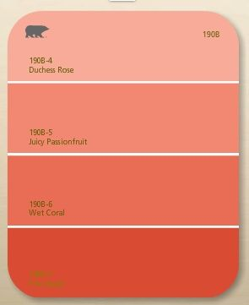
Tone and Mood Writing Activity:
Step 1:
Look carefully at your paint sample. What tone words come to mind when you look at the color on this paint sample? Red=LOVE/Passion
-Write your tone word in the top color
box.
-Write similar connotative words in the
following boxes! (Synonyms)
Love
Passion
Affection
Intimacy

Slide 44
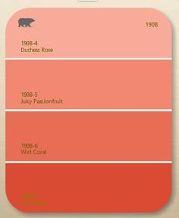
Tone and Mood Writing Activity:
Step 2:
Use the Character Card, the Genre Card, the Location Card, and the TONE paint sample to draft a short story!
Your reader should be able to identify the TONE through your writing. This is the word in the top box of your paint chip.
Use the synonyms you identified to help showcase the tone to the reader – but you cannot use the original tone word!
Love
Affection
Passion
Intimacy

Slide 45
Tone and Mood Writing Activity:
Example:
Love
1 Paint Sample Card
1 Character Card
1 Genre Card
1 Location Card
Passion
Dog Walker
Affection
Intimacy
Mystery
Your creative short story will be about a dog walker in a bakery! You will create a mysterious story that leaves the reader feeling the tone of LOVE! This mystery just may be a love story!
in a bakery

Slide 46
Tone and Mood Writing Activity:
Short Story Swap
Swap your story with two other students.
Read through the stories.
On a post-it, write down the tone word you feel is appropriate for each of the two stories.
Reflect on the post-its you have received on your stories!

Slide 47
Bell Ringer:
Read the passage in your notes packet. Determine the tone of the poem, and highlight or circle the words that reflect this tone.
Day 6
Today’s Agenda
Materials:
- Pencil & Computer
Digital and/or Printed Notes Document
Two Poems
Tone & Mood
Tone and Mood Black-Out Poetry Introduction
Homework: Begin Poetry Analysis
Notes:
Link to the prezi: http://prezi.com/rutfyydkimgn/?utm_campaign=share&utm_medium=copy&rc=ex0share

Slide 48
Bell Ringer:
The Bustle in the House ca. 1866
The Bustle in the House
The Morning after Death
Is solemnest of industries
Enacted upon the Earth—
The Sweeping up the Heart
And putting Love away
We shall not want to use again
Until Eternity.
The Bustle of the House- Emily Dickinson (1866)
Directions:
Read through the passage.
1.What is the tone of the poem?
2. What words showcase this tone?
3. What is the author’s tone at the end of the poem- hopeful, sad, resigned… WHY?

Slide 49
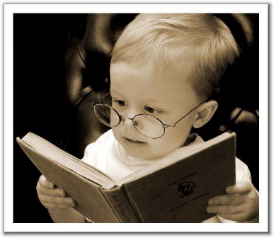
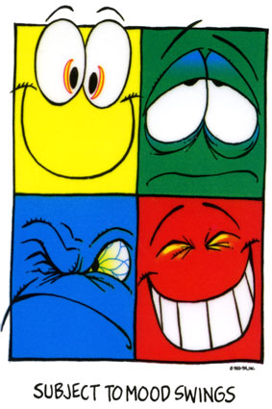
Tone and Mood Black-Out Poetry!
Read through the two poems provided in your notes
packet.
2. Identify the tone of each poem. Write this word at the
top of the page.
3. Put a box around the tone words.
4. Draw a picture of the mood over the top of the poem with pencil or black marker only.
5. Do not cover the tone boxes.
Tone Words or Phrases.

Slide 50
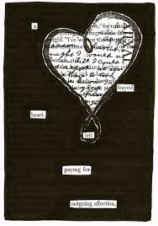
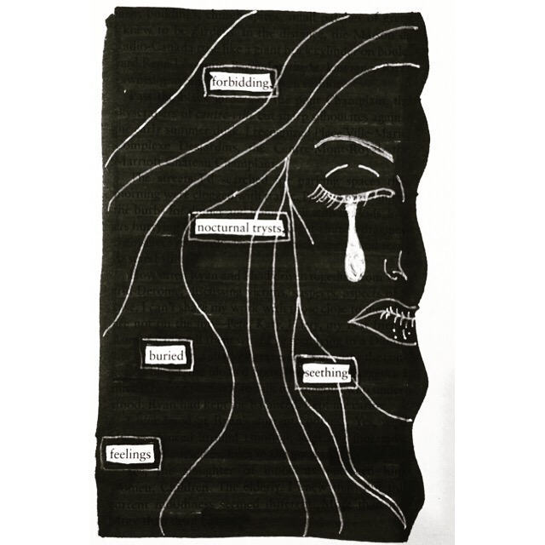
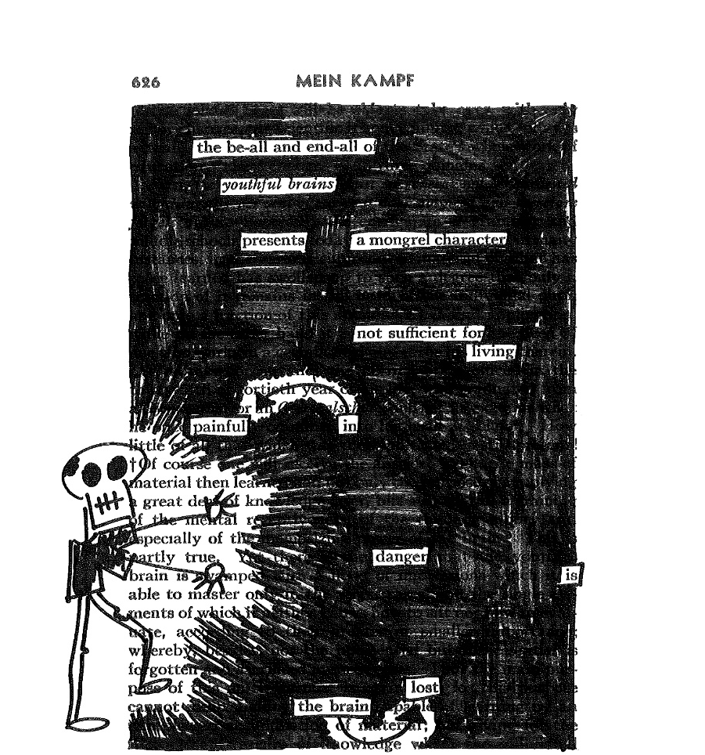
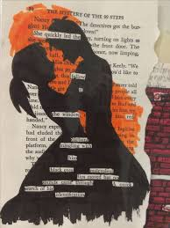
Examples:

Slide 51
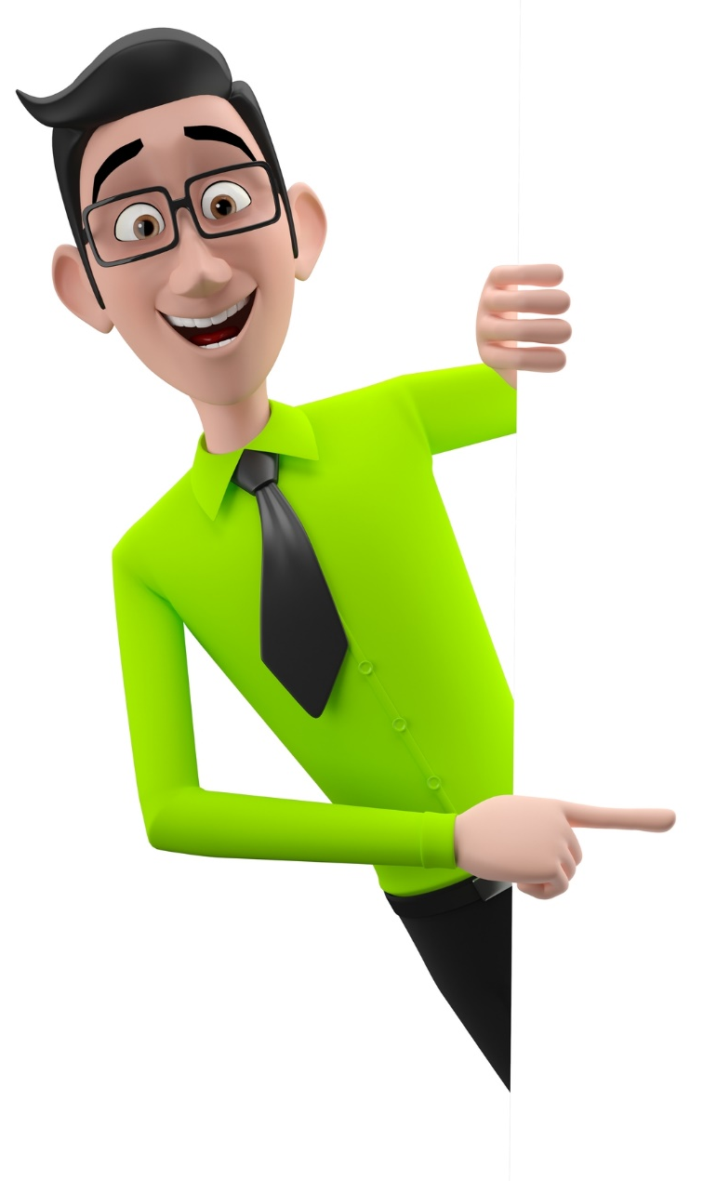
Tone Analysis Summative Assessment
Directions:
1. Choose one of the three passages to read and analyze for TONE.
2. Read the passage carefully. Determine the tone and mood of the passage.
3. Identify the words and phrases that support your TONE word.
4. Draft a literary analysis paragraph to justify your response. Use the graphic organizer provided to help you organize your thoughts. You must provide at least two (properly cited) examples to support your analysis.

