Slide 1
Satire
English III Honors
(Fall 2015)

Slide 2
Satire: The Definition
Satire is a technique used to expose and criticize foolishness and corruption of an individual or a society.

Slide 3
Satire is created by using:
Humor
Irony
Exaggeration
Ridicule

Slide 4
Satire: Its purpose
The role of satire is to ridicule or criticize those vices in the society which the writer considers a threat to civilization. To expose these vices for the betterment of humanity. Therefore, the function of satire is not to make others laugh at persons or ideas they make fun of. It intends to warn the public and to change their opinions about the prevailing corruption/conditions in society.

Slide 5
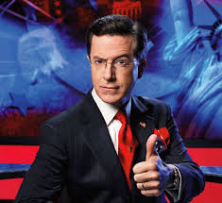
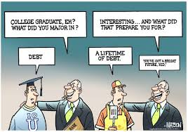
Examples of Satire Today?

Slide 7
Ice Bucket Challenge
https://www.youtube.com/watch?v=Tuquh0hEA5k&list=PLkGKEc_zcqixA2fjx4LgNuYEhI29kR5lG&index=5
What is being satirized?

Slide 8
Apple- Think Different(ly)
https://www.youtube.com/watch?v=WL2l_Q1AR_Q&index=3&list=PLkGKEc_zcqixA2fjx4LgNuYEhI29kR5lG
What is being satirized?

Slide 9
#Hashtag
https://www.youtube.com/watch?v=57dzaMaouXA&list=PLkGKEc_zcqixA2fjx4LgNuYEhI29kR5lG&index=4
What is being satirized?

