Slide 1
How to structure & organize your essay
Take notes on exactly what to include in each paragraph of your essay.
Honors English III

Slide 2
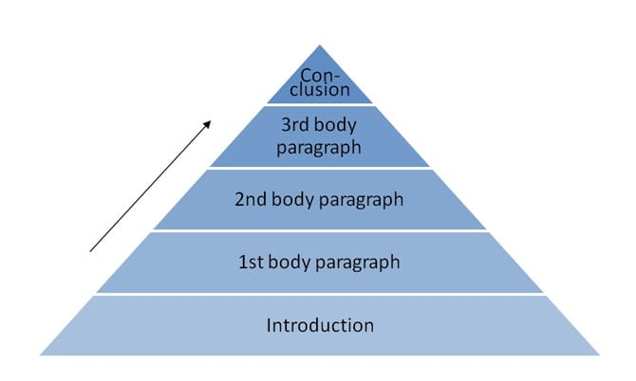
Your essay will have 5 paragraphs.

Slide 3
Paragraph 1: Introduction
Have a hook that engages the reader—say something interesting, a famous quote that relates to the topic of your essay, or ask an interesting question that would make the reader want to actually keep reading your essay
Next 2-3 sentences= background information/historical context about the speech
After that: Write a thesis statement (you make a claim that you try to prove in the body paragraphs)

Slide 4
Introduction Example:
Martin Luther King, Jr.’s iconic “I Have a Dream” speech is one that every student in the United States studies, reads, listens to and analyzes. But what makes this speech, “the speech” that every student learns?
During the 1960s, the United States was in the midst of turmoil as both African Americans and Women were fighting for equal recognition and access to opportunities. The large number of protests and gatherings to bring attention to these important issues, became known as both the Civil Rights Movement and the Women’s Movement. In 1963, specifically, Martin Luther King, Junior gave his most famous speech in Washington D.C. in front of 250,000 people. In this speech he described his own American Dream, as well as his hope for the future of America.
In his iconic “I Have A Dream” speech, MLK, Jr. effectively used rhetorical strategies to persuade his large audience of Americans— by creating an inspirational tone and hopeful mood and by incorporating abundant imagery that created pathos inside his audience.

Slide 5
Paragraph 2: Explain the speaker’s purpose, point of view, identify 2 claims, and the evidence the speaker gives to prove each claim.
Body Paragraph 1
Have a transition from the Intro paragraph
Have a topic sentence that states the speaker’s purpose and 2 claims that the speaker makes
Provide citations from the speech to prove the purpose and claims
Explain the citations and how they prove the purpose and claims
Summarize what the speaker’s purpose and claims were in this speech

Slide 6
Paragraph 3: Describe how the speaker uses the 3 Rhetorical Techniques (ethos, pathos, logos)
Body Paragraph 2
Have a transition connecting to the previous paragraph
State which rhetorical technique the speaker use most effectively
Provide citation to prove this
Explain that citation
State the rhetorical technique that the speaker used 2nd best
Provide a citation to prove this
Explain that citation
State the rhetorical technique used least by the speaker
Summarize which rhetorical technique the speaker used most effectively

Slide 7
Paragraph 4: Describe the tone and mood the speaker creates through his/her use of DIDLS.
Body Paragraph 3
Transition sentence that connects to the previous paragraph
State the tone of the speech
Provide citations (2) use DIDLS
Explain the citations
State the mood of the speech
Provide citations (2) using DIDLS
Explain citations
Summarize what the tone and mood are for this speech

Slide 8
Paragraph 5: Conclusion
Conclusion
Review the first body paragraph
Review the second body paragraph
Review the 3rd body paragraph
Check your thesis statement: explain one more time, your thesis from the introduction
Lastly, leave the reader with a powerful thought to consider

