Slide 1
Modernism
(1914-1939)

Slide 2
“The American Dream” concept
America as a “New Eden”
a land of beauty, bounty, and unlimited promise! (Get excited!!)
2. A Belief in Progress
optimism and opportunity
3. Triumph of The Individual
independence and self-reliance

Slide 3
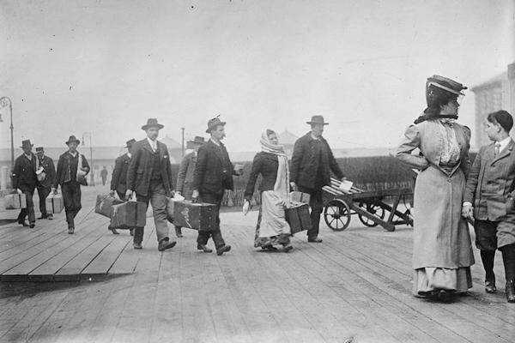

Slide 4
What happened in 1914?
World War I

Slide 5
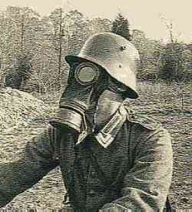
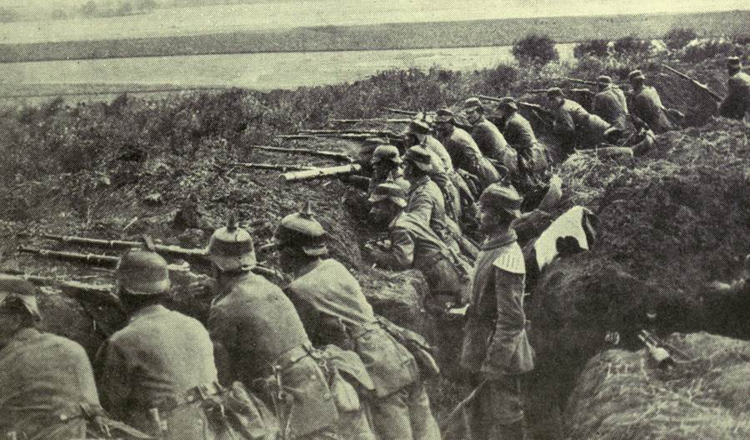
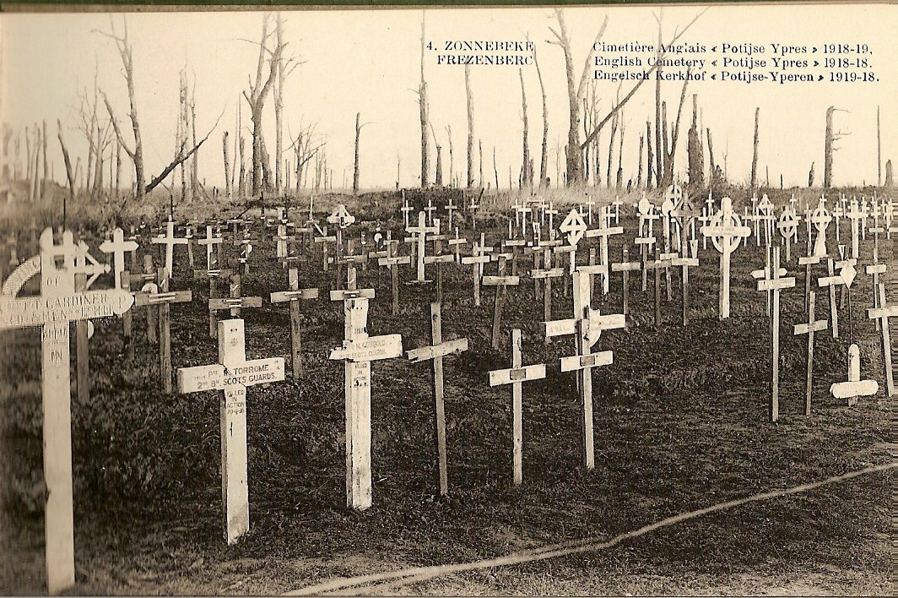
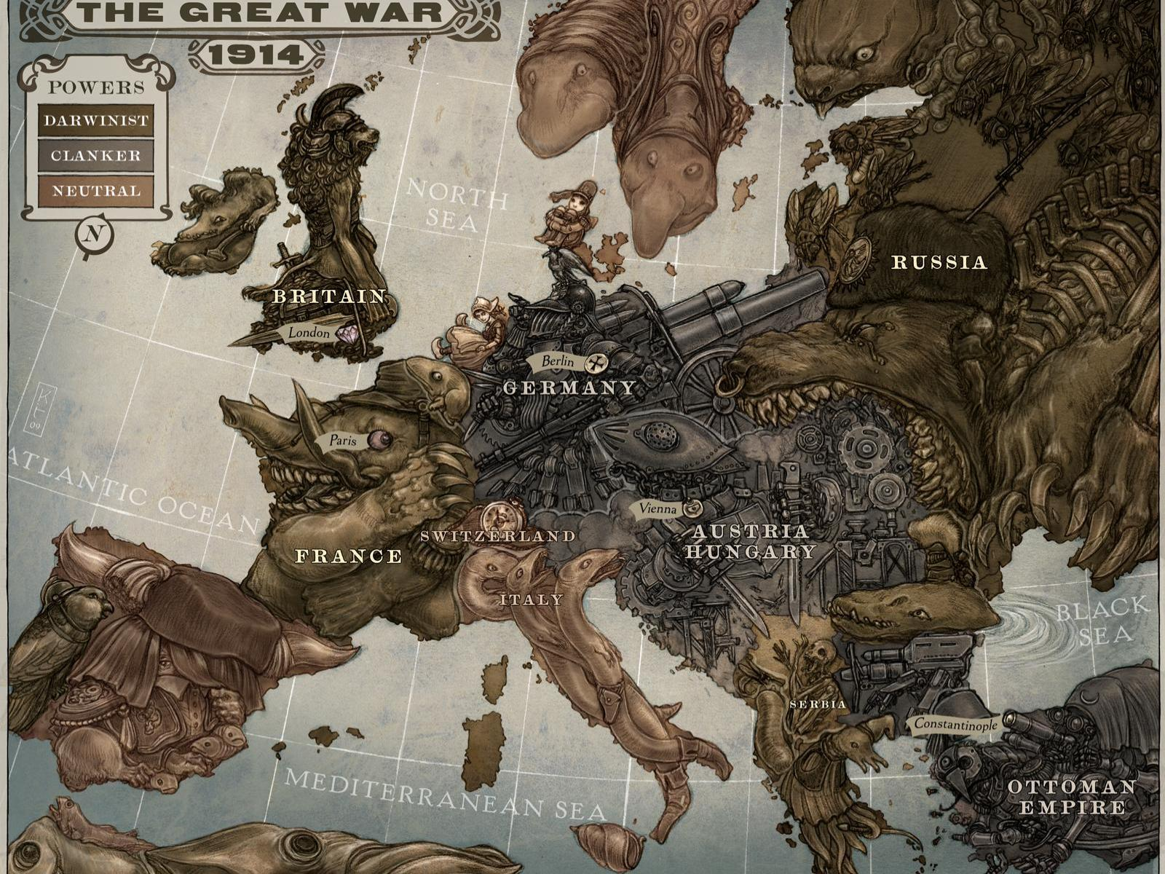

Slide 6
The Great War (1914)
WWI began in 1914 with the assassination of Archduke Franz Ferdinand of Austria-Hungary
The U.S. entered the war in 1917
Nearly 50 million lives were lost
The Treaty of Versailles ended the war in June 1919

Slide 7
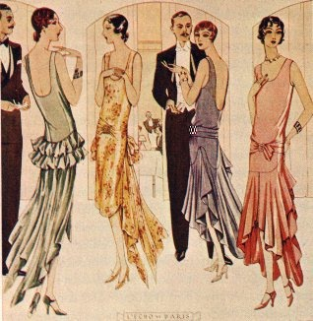
What happened in 1919?
Prohibition: the manufacture and sale of alcohol were prohibited by the 18th Amendment
Instead of encouraging traditional values,
Prohibition brought…
Bootleggers
Speak-easies and Cocktails
Flappers
Gangsters (Real OGs)
Jazz

Slide 8
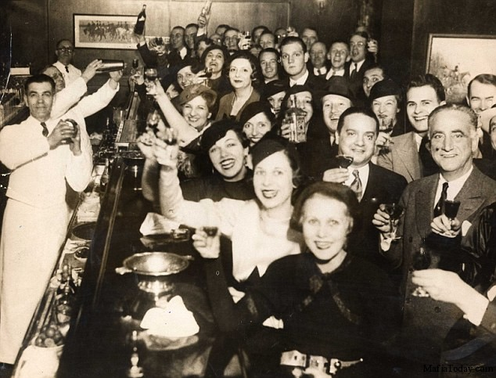
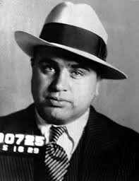
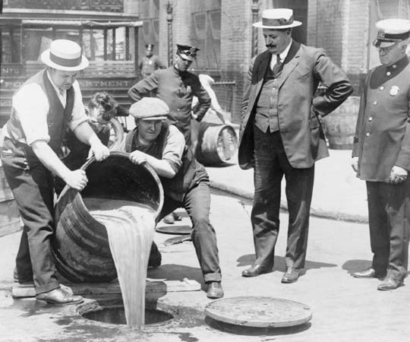

Slide 9
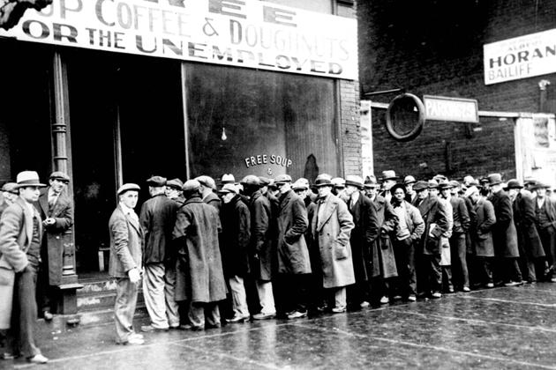
What Happened in 1929?
-The stock market crashed
-The beginning of The Great Depression

Slide 10
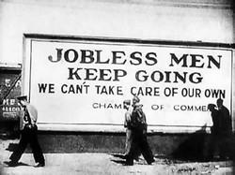
The Great Depression
1. Poverty
2. Loss of Jobs
3. Starvation
4. Millions of Americans were jobless, homeless, and hopeless

Slide 11
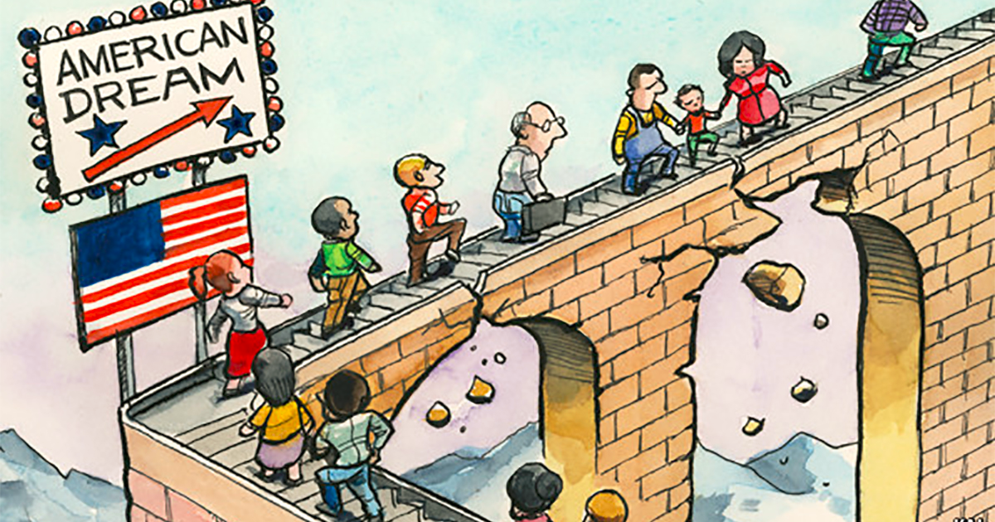
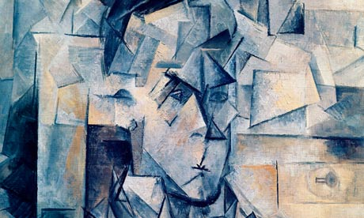
A loss of faith in the American Dream
All of this led to...

Slide 12
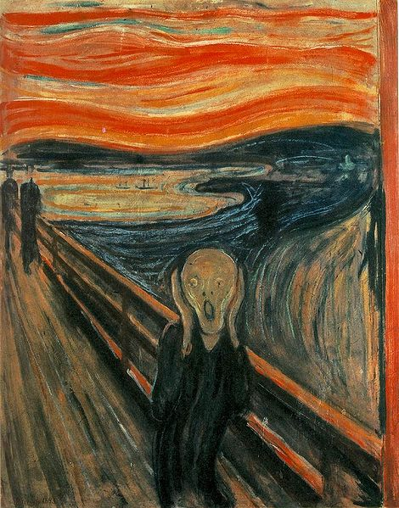
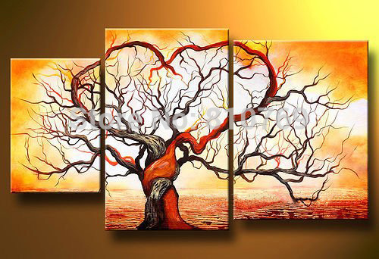
And the “Modern” Time Period was established

Slide 13
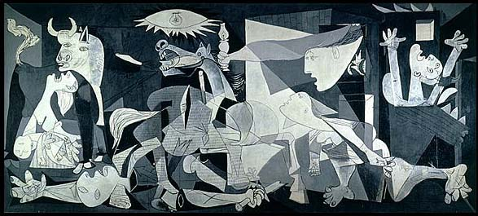
Characteristics of Modernism
Bold experimentation in style and form representing the fragmentation of society

Slide 14
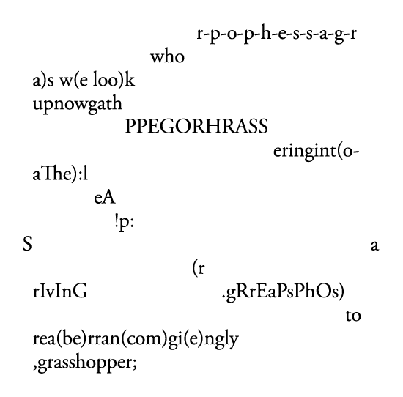
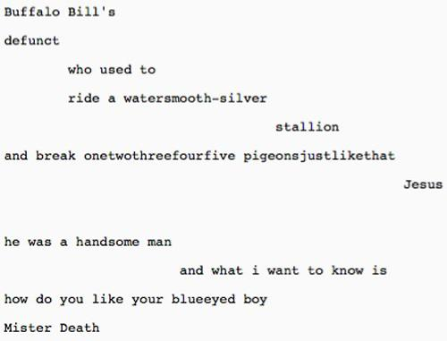
Example: e.e. cummings
Grasshopper
Buffalo Bill’s

Slide 15
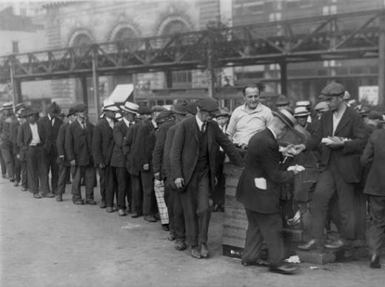
Characteristics Cont.
2. Disillusionment: a feeling of disappointment resulting from the discovery that something is not as good as one believed it to be

Slide 16
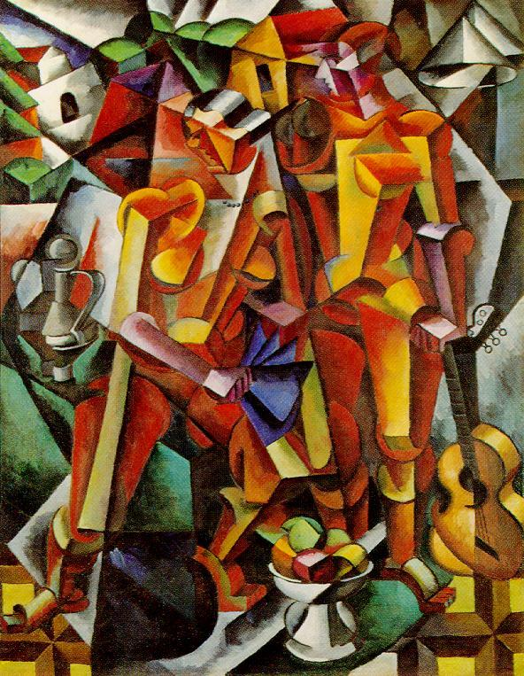
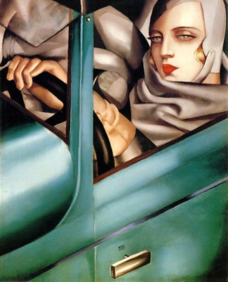
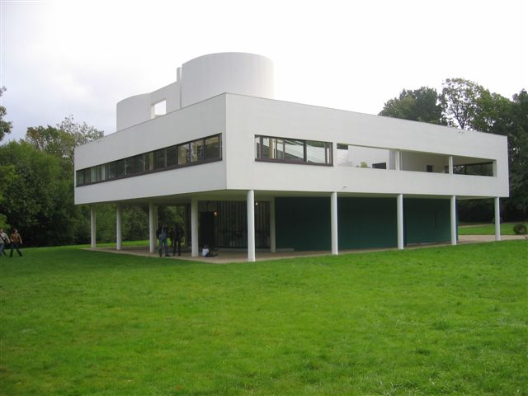
Characteristics Cont.
3. Rejection of tradition in all
areas!

Slide 17
Characteristics Cont.
4. The Hemingway Hero: Heroes who are flawed and disillusioned, but they show “grace under pressure” (endurance, honor, and courage)

Slide 18
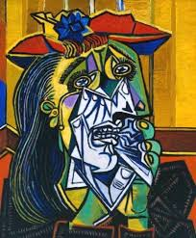
Characteristics Cont.
5. Psychoanalysis:
Introduced by Sigmund Freud
Interested in the inner workings of the human mind
Stream of Consciousness writing

