Slide 1
MLA Format Examples
PLEASE REVIEW THESE EXAMPLES IF YOU HAVE QUESTIONS

Slide 2
In-text citations: Author-page style
MLA format follows the author-page method of in-text citation. This means that the author's last name and the page number(s) from which the quotation or paraphrase is taken must appear in the text, and a complete reference should appear on your Works Cited page. The author's name may appear either in the sentence itself or in parentheses following the quotation or paraphrase, but the page number(s) should always appear in the parentheses, not in the text of your sentence. For example:
Wordsworth stated that Romantic poetry was marked by a "spontaneous overflow of powerful feelings" (263).
Romantic poetry is characterized by the "spontaneous overflow of powerful feelings" (Wordsworth 263).
Wordsworth extensively explored the role of emotion in the creative process (263).

Slide 3
In-text citations for print sources with no known author
When a source has no known author, use a shortened title of the work instead of an author name. Place the title in quotation marks if it's a short work (such as an article) or italicize it if it's a longer work (e.g. plays, books, television shows, entire Web sites) and provide a page number.
We see so many global warming hotspots in North America likely because this region has "more readily accessible climatic data and more comprehensive programs to monitor and study environmental change . . ." ("Impact of Global Warming" 6).

Slide 4
In-text citations for print sources with known author
For Print sources like books, magazines, scholarly journal articles, and newspapers, provide a signal word or phrase (usually the author’s last name) and a page number. If you provide the signal word/phrase in the sentence, you do not need to include it in the parenthetical citation.
Human beings have been described by Kenneth Burke as "symbol-using animals" (3).
Human beings have been described as "symbol-using animals" (Burke 3).

Slide 5
Citing non-print or sources from the Internet
For electronic and Internet sources, follow the following guidelines:
Include in the text the first item that appears in the Work Cited entry that corresponds to the citation (e.g. author name, article name, website name, film name).
You do not need to give paragraph numbers or page numbers based on your Web browser’s print preview function.
Unless you must list the Web site name in the signal phrase in order to get the reader to the appropriate entry, do not include URLs in-text. Only provide partial URLs such as when the name of the site includes, for example, a domain name, likeCNN.com or Forbes.com as opposed to writing out http://www.cnn.com or http://www.forbes.com.

Slide 6
Format: General Guidelines
Type on white 8.5“ x 11“ paper
Double-space everything
Use 12 pt. Times New Roman font (or similar font)
Leave only one space after punctuation
Set all margins to 1 inch on all sides
Indent the first line of paragraphs one half-inch
Notes:
･Type your paper on a computer and print it out on standard, white 8.5 x 11-inch paper
･Double-space the text of your paper, and use a legible font (e.g. Times New Roman). Whatever font you choose, MLA recommends that the regular and italics type styles contrast enough that they are recognizable one from another. The font size should be 12 pt
･Leave only one space after periods or other punctuation marks (unless otherwise instructed by your instructor).
･Set the margins of your document to 1 inch on all sides
･Indent the first line of paragraphs one half-inch from the left margin. MLA recommends that you use the Tab key as opposed to pushing the Space Bar five times.

Slide 7
Formatting the 1st Page
No title page
Double space everything
In the upper left corner of the 1st page, list your
name, your instructor's name, the course, and date
Center the paper title (use standard caps but no underlining, italics, quote, or bold)
Create a header in the upper right corner at half inch from the top and one inch from the right of the page (include your last name and page number)
Notes:
･Do not make a title page for your paper unless specifically requested
･In the upper left-hand corner of the first page, list your name, your instructor's name, the course, and the date. Again, be sure to use double-spaced text.
･Double space again and center the title.
Do not underline, italicize, or place your title in quotation marks; write the title in Title Case (standard capitalization), not in all capital letters.
･Use quotation marks and/or italics when referring to other works in your title, just as you would in your text: Fear and Loathing in Las Vegas as Morality Play; Human Weariness in “After Apple Picking“
･Double space between the title and the first line of the text.
･Create a header in the upper right-hand corner that includes your last name, followed by a space with a page number; number all pages consecutively with Arabic numerals (1, 2, 3, 4, etc.), one-half inch from the top and flush with the right margin. (Note: Your instructor or other readers may ask that you omit last name/page number header on your first page. Always follow instructor guidelines.)
7

Slide 8
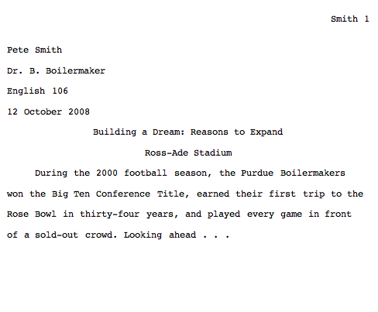
Sample 1st Page
Notes:
･Do not make a title page for your paper unless specifically requested
･In the upper left-hand corner of the first page, list your name, your instructor's name, the course, and the date. Again, be sure to use double-spaced text.
･Double space again and center the title.
Do not underline, italicize, or place your title in quotation marks; write the title in Title Case (standard capitalization), not in all capital letters.
･Use quotation marks and/or italics when referring to other works in your title, just as you would in your text: Fear and Loathing in Las Vegas as Morality Play; Human Weariness in “After Apple Picking“
･Double space between the title and the first line of the text.
･Create a header in the upper right-hand corner that includes your last name, followed by a space with a page number; number all pages consecutively with Arabic numerals (1, 2, 3, 4, etc.), one-half inch from the top and flush with the right margin. (Note: Your instructor or other readers may ask that you omit last name/page number header on your first page. Always follow instructor guidelines.)
8

Slide 9
Author-Page Style
In-text Example:
Wordsworth stated that Romantic poetry was marked by a “spontaneous overflow of powerful feelings” (263).
Romantic poetry is characterized by the “spontaneous overflow of powerful feelings” (Wordsworth 263). Wordsworth extensively explored the role of emotion in the creative process (263).
Corresponding Works Cited Entry:
Wordsworth, William. Lyrical Ballads. London: Oxford
UP, 1967. Print.
Notes:
In-Text Citations: Author-Page Style
MLA format follows the author-page method of in-text citation. This means that the author's last name and the page number(s) from which the quotation or paraphrase is taken must appear in the text, and a complete reference should appear on your Works Cited page. The author's name may appear either in the sentence itself or in parentheses following the quotation or paraphrase, but the page number(s) should always appear in the parentheses, not in the text of your sentence.
The both citations in the in-text examples on this slide, (263) and (Wordsworth 263), tell readers that the information in the sentence can be located on page 263 of a work by an author named Wordsworth. If readers want more information about this source, they can turn to the Works Cited page, where, under the name of Wordsworth, they would find the information in the corresponding Works Cited entry also shown on this slide. Reduce font size on slide to allow breathing room and space. Also, use a different font for the sample text so instructions look different from the excerpt.
9

Slide 10
Print Source with Author
Corresponding Works Cited Entry:
Burke, Kenneth. Language as Symbolic Action: Essays
on Life, Literature, and Method. Berkeley: U of
California P, 1966. Print.
Notes:
And this is how the Works Cited listing should look.

Slide 11
With Unknown Author
Corresponding Works Cited Entry:
“The Impact of Global Warming in North America.”
Global Warming: Early Signs. 1999. Web. 23 Mar.
2009.
Notes:
And this is how the Works Cited listing should look.

Slide 12
Other In-Text Citations 7
Sources from the Internet
In-text Example:
One online film critic stated that Fitzcarraldo is “...a beautiful and terrifying critique of obsession and colonialism” (Garcia, “Herzog: a Life”).
Corresponding Works Cited Entry:
Garcia, Elizabeth. “Herzog: a Life.“ Online Film Critics Corner. The Film School of New Hampshire, 2 May 2002. Web. 8 Jan. 2009.
Notes:
Sources from the Internet
With more and more scholarly work being posted on the Internet, you may have to cite research you have completed in virtual environments. While many sources on the Internet should not be used for scholarly work (reference the OWL's Evaluating Sources of Information resource located here: http://owl.english.purdue.edu/owl/resource/553/01/), some Web sources are perfectly acceptable for research. When creating in-text citations for electronic, film, or Internet sources, remember that your citation must reference the source in your Works Cited.
Sometimes writers are confused with how to craft parenthetical citations for electronic sources because of the absence of page numbers, but often, these sorts of entries do not require any sort of parenthetical citation at all. For electronic and Internet sources, follow the following guidelines:
･Include in the text the first item that appears in the Work Cited entry that corresponds to the citation (e.g. author name, article name, website name, film name).
･You do not need to give paragraph numbers or page numbers based on your Web browserﾕs print preview function.
･Unless you must list the website name in the signal phrase in order to get the reader to the appropriate entry, do not include URLs in-text. Only provide partial URLs such as when the name of the site includes, for example, a domain name, like CNN.com or Forbes.com as opposed to writing out http://www.cnn.com or http://www.forbes.com.
12

Slide 13
Formatting Short Quotations
In-text Examples:
According to some, dreams express “profound aspects of personality” (Foulkes 184), though others disagree.
According to Foulkes's study, dreams may express “profound aspects of personality” (184).
Is it possible that dreams may express “profound aspects of personality” (Foulkes 184)?
Cullen concludes, “Of all the things that happened there / That's all I remember” (11-12).
Notes:
Short Quotations
To indicate short quotations (fewer than four typed lines of prose or three lines of verse) in your text, enclose the quotation within double quotation marks. Provide the author and specific page citation (in the case of verse, provide line numbers) in the text, and include a complete reference on the Works Cited page. Punctuation marks such as periods, commas, and semicolons should appear after the parenthetical citation. Question marks and exclamation points should appear within the quotation marks if they are a part of the quoted passage but after the parenthetical citation if they are a part of your text. This is all illustrated in the first three examples on this slide.
Mark breaks in short quotations of verse with a slash, /, at the end of each line of verse (a space should precede and follow the slash). This is illustrated in the last example on this slide.
13

Slide 14
Formatting Long Quotations
In-text Example:
Nelly Dean treats Heathcliff poorly and dehumanizes him throughout her narration:
They entirely refused to have it in bed with them, or even in their room, and I had no more sense, so, I put it on the landing of the stairs, hoping it would be gone on the morrow. By chance, or else attracted by hearing his voice, it crept to Mr. Earnshaw's door, and there he found it on quitting his chamber. Inquiries were made as to how it got there; I was obliged to confess, and in recompense for my cowardice and inhumanity was sent out of the house. (Bronte 78)
Notes:
Long Quotations
For quotations that are four or more lines of verse or prose: place quotations in a free-standing block of text and omit quotation marks. Start the quotation on a new line, with the entire quote indented one inch from the left margin; maintain double-spacing. Only indent the first line of the quotation by a half inch if you are citing multiple paragraphs. Your parenthetical citation should come after the closing punctuation mark. When quoting verse, maintain original line breaks. (You should maintain double-spacing throughout your essay.)
14

Slide 15
Adding/Omitting Words
In-text Example for Adding Words:
Jan Harold Brunvand, in an essay on urban legends, states: “some individuals [who retell urban legends] make a point of learning every rumor or tale” (78).
In-text example for Omitting Words:
In an essay on urban legends, Jan Harold Brunvand notes that “some individuals make a point of learning every recent rumor or tale . . . and in a short time a lively exchange of details occurs” (78).
Notes:
Adding or Omitting Words In Quotations
If you add a word or words in a quotation, you should put brackets around the words to indicate that they are not part of the original text. This is illustrated in the first example on this slide.
If you omit a word or words from a quotation, you should indicate the deleted word or words by using ellipsis marks, which are three periods ( . . . ) preceded and followed by a space. Please note that brackets are not needed around ellipses unless adding brackets would clarify your use of ellipses. This is illustrated in the second example on this slide.
15

Slide 16
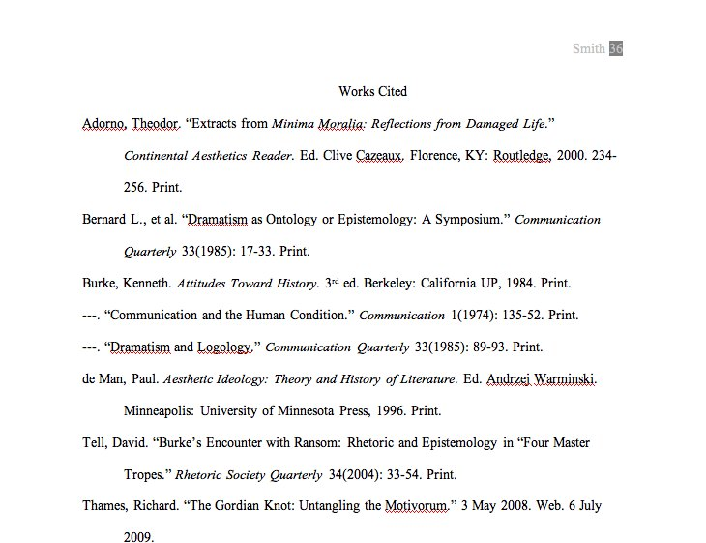
Works Cited Page: The Basics
Notes:
Basic Rules
･Begin your Works Cited page on a separate page at the end of your research paper. It should have the same one-inch margins and last name, page number header as the rest of your paper.
･Label the page Works Cited (do not italicize the words Works Cited or put them in quotation marks) and center the words Works Cited at the top of the page.
･Double space all citations, but do not skip spaces between entries.
･Indent the second and subsequent lines of citations five spaces so that you create a hanging indent.
･List page numbers of sources efficiently, when needed. If you refer to a journal article that appeared on pages 225 through 250, list the page numbers on your Works Cited page as 225-50.
Additional Basic Rules New to MLA 2009
･For every entry, you must determine the Medium of Publication. Most entries will likely be listed as Print or Web sources, but other possibilities may include Film, CD-ROM, or DVD.
･Writers are no longer required to provide URLs for Web entries. However, if your instructor or publisher insists on them, include them in angle brackets after the entry and end with a period. For long URLs, break lines only at slashes.
･If you're citing an article or a publication that was originally issued in print form but that you retrieved from an online database, you should type the online database name in italics. You do not need to provide subscription information in addition to the database name.Capitalization and Punctuation
･Capitalize each word in the titles of articles, books, etc, but do not capitalize articles, short prepositions, or conjunctions unless one is the first word of the title or subtitle
･New to MLA 2009: Use italics (instead of underlining) for titles of larger works (books, magazines) and quotation marks for titles of shorter works (poems, articles)
Listing Author Names
Entries are listed by author name (or, for entire edited collections, editor names). Author names are written last name first; middle names or middle initials follow the first name.
Do not list titles (Dr., Sir, Saint, etc.) or degrees (PhD, MA, DDS, etc.) with names. A book listing an author named “John Bigbrain, PhD“ appears simply as “Bigbrain, John“; do, however, include suffixes like “Jr.“ or “II.“ Putting it all together, a work by Dr. Martin Luther King, Jr. would be cited as “King, Martin Luther, Jr.,“ with the suffix following the first or middle name and a comma.
More than One Work by an Author
If you have cited more than one work by a particular author, order the entries alphabetically by title, and use three hyphens in place of the author's name for every entry after the first.
Work with No Known Author
Alphabetize works with no known author by their title; use a shortened version of the title in the parenthetical citations in your paper.
16

Slide 17
Web Source Format:
Editor, author, or compiler name (if available). “Article Name.” Name of Site. Version number. Name of institution/organization affiliated with the site (sponsor or publisher). Date of last update. Medium of publication. Date of access
Examples:
Bernstein, Mark. “10 Tips on Writing the Living Web.” A List Apart: For People Who Make Websites. A List Apart Mag., 16 Aug. 2002. Web. 4 May 2009.
Felluga, Dino. Guide to Literary and Critical Theory. Purdue U, 28 Nov. 2003. Web. 10 May 2006.
“How to Make Vegetarian Chili.” eHow.com. eHow. n.d. Web. 24 Feb. 2009.

Slide 18
Still Need Help ??? have no fear…
The Purdue OWLhttp://owl.english.purdue.edu

