Slide 1
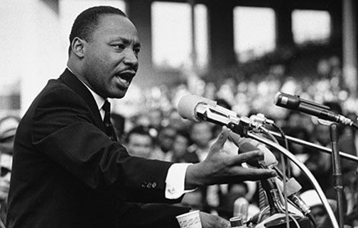
The Art of Persuasion: Rhetoric
Introduction to and Overview of
Rhetoric
(updated 9/17)

Slide 2
Rhetoric and Speech Analysis
Rhetoric Definition = the art and ability to use language to persuade others

Slide 3
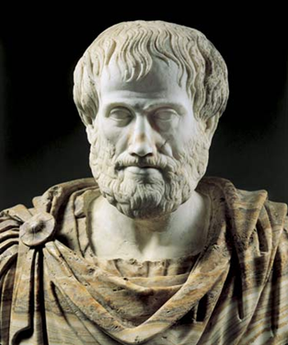
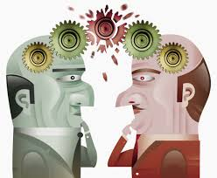
Aristotle stated:
Quintilian proposed that:
“Rhetoric is the ability to observe any given situation (the context) and determine what options are available to persuade others.”
"Rhetoric is the art of speaking well" or "... A good man speaking well.“

Slide 4
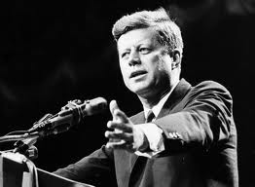
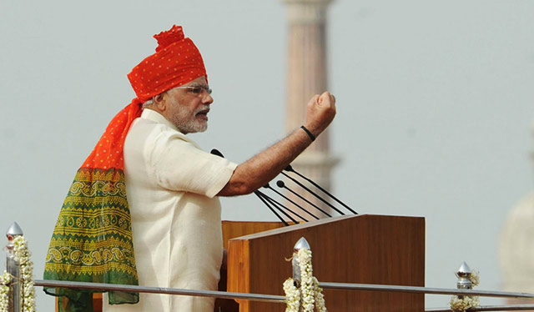
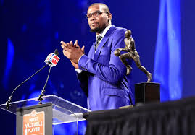
Rhetoric and Speech Analysis
Those who give speeches go by many names:
Rhetorician
Orator
Public Speaker

Slide 5
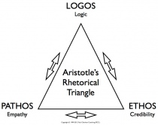
Aristotle said that there are 3 ways that a speaker can persuade or convince his or her audience to do something:
Use the Rhetorical Triangle!!!

Slide 6
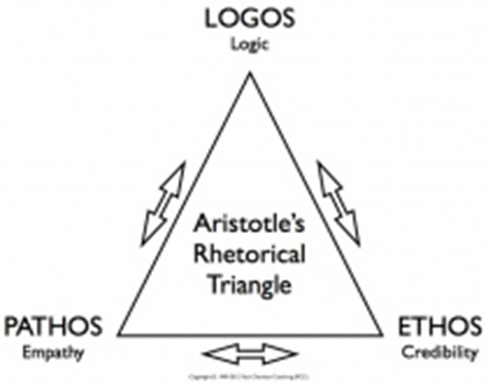
Aristotle said that there are 3 ways that a speaker can persuade or convince his or her audience to do something:
A Speaker can use one or any combination of the following from the rhetorical triangle:
Ethos
Logos
Pathos

Slide 7
Technique # 1 Ethos
1. Ethos uses the credibility of the speaker to persuade others.
2. It is similar to “street cred” because of the character or reputation of the speaker
3. We tend to believe people who we respect. There is a need to convince the audience that you are someone worth listening to.

Slide 8
Technique # 2 Logos
1. Logos is an appeal to logic, which uses facts, statistics, evidence, and numbers to convince and prove a point.
2. Giving logical reasons is the heart of rhetoric/argumentation, and cannot be emphasized enough!

Slide 9
Technique # 3 Pathos
1. Pathos is an appeal to the emotions of the audience, an appeal to their sympathies, fears, or imaginations.
2. The speaker tries to convince the audience through awakening their emotional connection to a particular subject or idea.
3. Language choice (diction) affects the audience's emotional response.
What emotion is the audience experiencing in the photo at the top right corner?

Slide 10
The Rhetorical Triangle
Copy these 3 techniques onto the back of your notes and begin incorporating them into your writing and speeches ASAP!

Slide 11
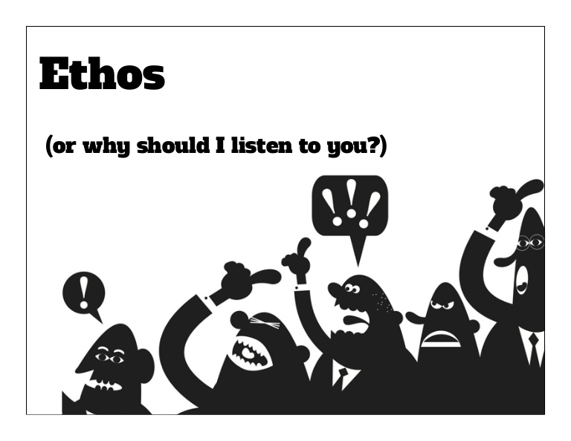
Rhetorical Triangle Notes:
Logos:
1. ___________________________
2. ___________________________
3. ___________________________
Ethos:
1. __________________
2. __________________
3. __________________
Pathos:
1. _____________________
2. _____________________
3. _____________________

Slide 12
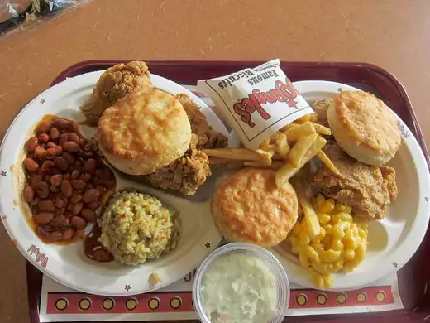
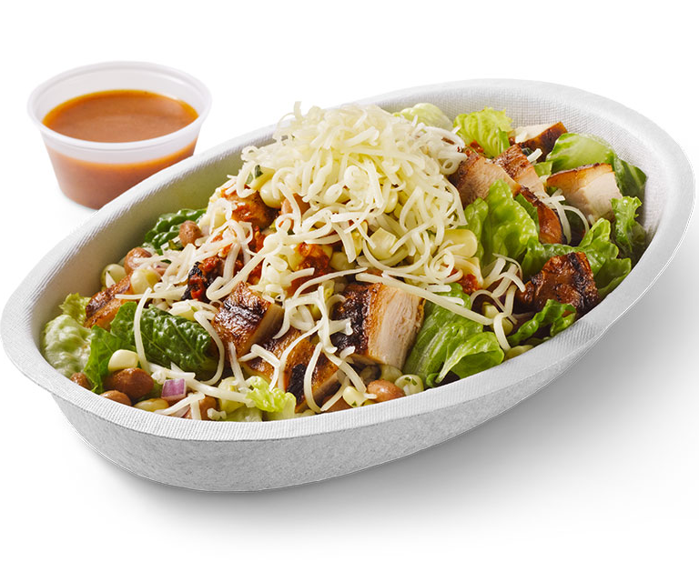
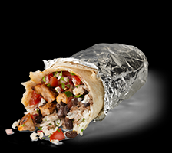
Time to Practice your Persuasion! As a Table, think about the changes in your “rhetorical technique” you would make in each of these scenarios:
How might you go about asking your mom or grandma to buy you lunch on a Saturday? [Write a 2-3 sentence example of exactly what you might say. Tell me: Are you primarily using Ethos, Pathos, or Logos?]
Compare that with how you might ask a sibling to buy you lunch on a Saturday…[Write a 2-3 sentence example of exactly what you might say. Tell me: Are you primarily using Ethos, Pathos, or Logos?]
Lastly, how might you ask your best friend to buy you lunch on a Saturday? [Write a 2-3 sentence example of exactly what you might say. Tell me: Are you primarily using Ethos, Pathos, or Logos?]

