Slide 1
10 Tips from Lincoln on Writing a Phenomenal Speech
What we can learn from the Gettysburg Address

Slide 2
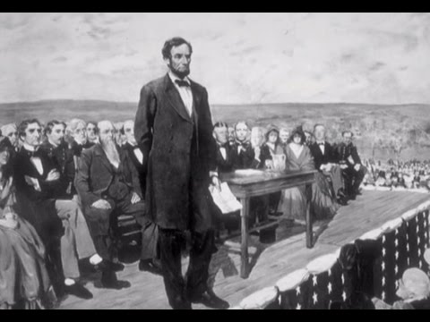
Slowly read the Gettysburg Address
(Don’t worry; it’s short!)

Slide 3
G-burg Address: So famous and So short
Four score and seven years ago our fathers brought forth, on this continent, a new nation, conceived in Liberty, and dedicated to the proposition that all men are created equal.
Now we are engaged in a great civil war, testing whether that nation, or any nation so conceived, and so dedicated, can long endure. We are met on a great battle-field of that war. We have come to dedicate a portion of that field, as a final resting-place for those who here gave their lives, that that nation might live. It is altogether fitting and proper that we should do this.
But, in a larger sense, we can not dedicate, we can not consecrate – we can not hallow – this ground. The brave men, living and dead, who struggled here, have consecrated it far above our poor power to add or detract. The world will little note, nor long remember what we say here, but it can never forget what they did here. It is for us the living, rather, to be dedicated here to the unfinished work which they who fought here have thus far so nobly advanced. It is rather for us to be here dedicated to the great task remaining before us – that from these honored dead we take increased devotion to that cause for which they here gave the last full measure of devotion - that we here highly resolve that these dead shall not have died in vain – that this nation, under God, shall have a new birth of freedom, and that government of the people, by the people, for the people, shall not perish from the earth.

Slide 4
1. Keep it short
Every year, Congress is forced to listen to the President give the State of the Union Address for more than an hour.
Lincoln’s famous speech followed a two-hour oration by Edward Everett that was 13,607 words long.
By contrast, Lincoln’s speech lasted for two minutes, and was 10 sentences (or 272 words) long. But it was much more powerful.
Tip: Keep it short. Capture the key emotions and ideas you want to convey in as little time as possible. If you can deliver a two-minute speech, instead of a 30-minute droner, your audience will actually listen, and they will love you for your brevity.

Slide 5
2. Abandon the formalities and leave out the two-thousand “thank yous”
The President usually starts the State of the Union Address by acknowledging all the dignitaries, politicians, and thanking a other million people. Many other speakers make this same mistake, and ruin their speeches.
By the time you’re done acknowledging and thanking everyone, you’ve lost your audience.
Tip: Go right into the heart of the issue, and your audience will pay attention. Lincoln skipped the formalities and “thank yous” and began with the key to his speech.

Slide 6
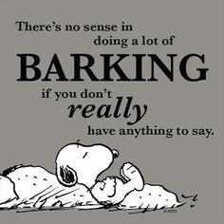
3. Have a clear purpose
Speak to communicate a clear message, and inspire your audience
Don’t just get up to speak and make yourself sound good or your organization look good.
Lincoln did this by stimulating his troops’ purpose (aka motivating and inspiring them) and resolve to win a war for the ideals of the forefathers of the United States.

Slide 7
4. Connect to your audience’s hearts
A speech is not a logical argument, or a listing of accomplishments or facts or events.
Lincoln knew his audience, and spoke to their emotions, by showing them that the men who died on the battlefield of Gettysburg did so for certain ideals, and asking them to ensure that those soldiers did not die in vain.

Slide 8
5. Speak to Larger Truths
While it isn’t best to be too grandiose, especially if you are speaking to small audience like your child’s 2nd grade class on career day, it’s best if you connect your ideas and words to larger causes and ideals, as Lincoln did when he connected the cause of the Union to the ideals of liberty and equality conceived by the forefathers of the nation.

Slide 9
6. Speak to the larger audience
When you give a speech, the audience is not just to those in front of you.
Lincoln knew that the Gettysburg address was not really addressed to the audience before him, but to a larger audience: the entire nation as a whole (and perhaps to history).
His short little speech was reprinted across the nation, and it had an effect on many people.
This happens today — speeches by Steve Jobs, for example, are not just for the audience at the conference, but to the entire world.
Think about how a speech will affect a greater audience, and what message you want to convey to them. With the Internet, your speech can be communicated to many others beyond the immediate audience.

Slide 10
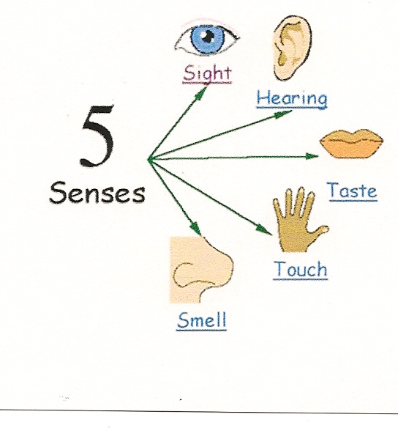
7. Use imagery to help the audience envision your ideas in their minds
Lincoln used imagery for birth and life and death — “conceived” and “brought forth” and “perish”.
It is important to do more than use bland words, but to create a picture in people’s minds through your words.
The imagery, of course, should be related to your central theme.

Slide 11
8. Use allusions/reference other famous lines/phrases
Lincoln opened his speech with a line from a more famous (at that time) document, the Declaration of Independence (“that all men are created equal”).
The reference brings with it many ideas and emotions associated with the Declaration of Independence and the men who signed it.
Other famous lines that could be referenced include the Bible, Shakespeare, poetry, songs, books, other speeches.
The references bring a lot more with them than just the phrase or quote you use, if your audience is familiar with it.

Slide 12
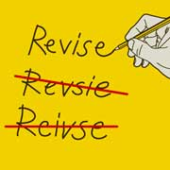
9. Revise. Revise. Revise.
Lincoln wrote several versions of his speech before settling on the final version.
Each revision should cut out the unnecessary words or ideas.
Tip: Develop the central idea, make the words flow more smoothly, and use powerful imagery and phrases that will impact the audience.

Slide 13
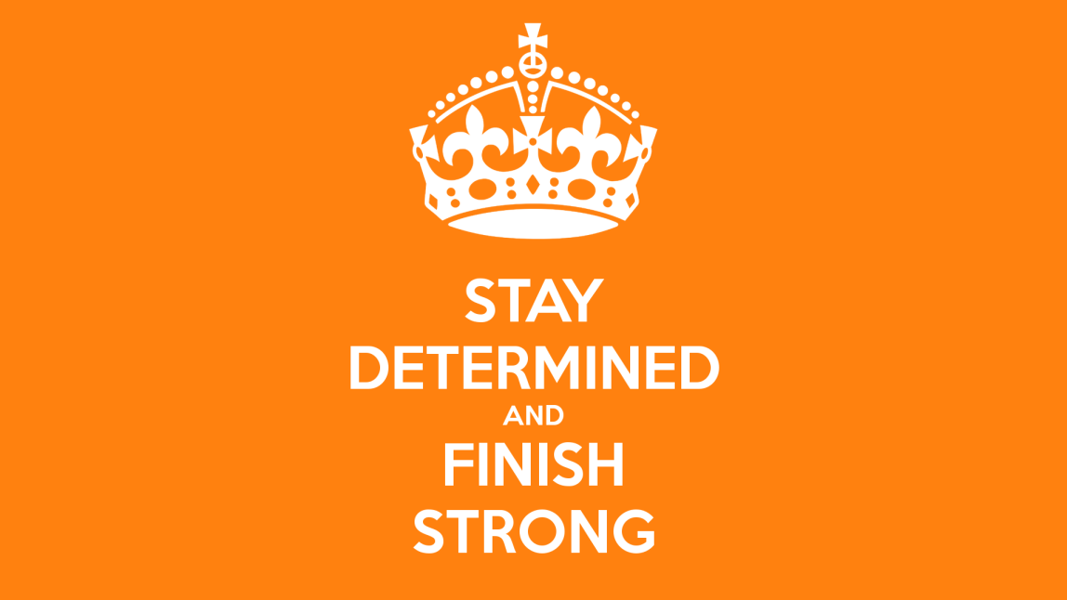
10. Always end strong!
Lincoln ended the Gettysburg Address with the line “that government of the people, by the people, for the people, shall not perish from the earth.” And that line went down in history.
Tip: End with a line people will remember, that contains the message you want them to remember, because, aside from the opening, it’s the most important line.

Slide 14
Rhetorical Devices you need to know:
Alliteration
Anaphora
Repetition
(Extended) Metaphor

Slide 15
This week, you will have to evaluate your iconic speech based on these 10 tips.
Is the speech short?
Does the speaker abandon formalities?
Is there a clear purpose? (thesis)
Does the speech connect to the audience’s hearts?
Doe the speech speak to larger truths? How so? How not?
Does the speech reach larger audiences? How so? How not?
Does the speech incorporate imagery? Where? When?
Where are the allusions/references to other famous people or events?
Where’s the evidence of the revising process?
Is there a powerful ending to the speech? How so? How not?

